Slide 1
Azure Stream Analytics

Slide 2
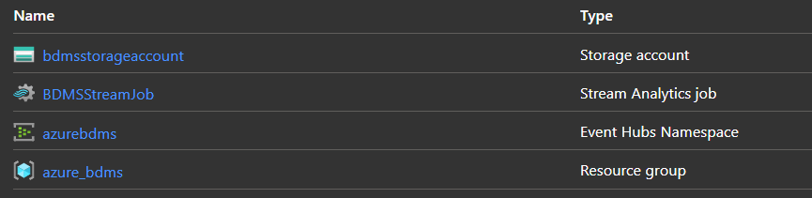
Project Architecture
Everything is running on Azure platform. Within the resource group called azure_bdms, we have created an eventhub Namespace called “azuredbms”, in which we run an eventhub called “bdmsdemo”. We have set a storage account, “bdmsstogrageaccount” to import input data and receive output, and a stream analytics job “BDMSStreamJob” to process the data we get.

Slide 3
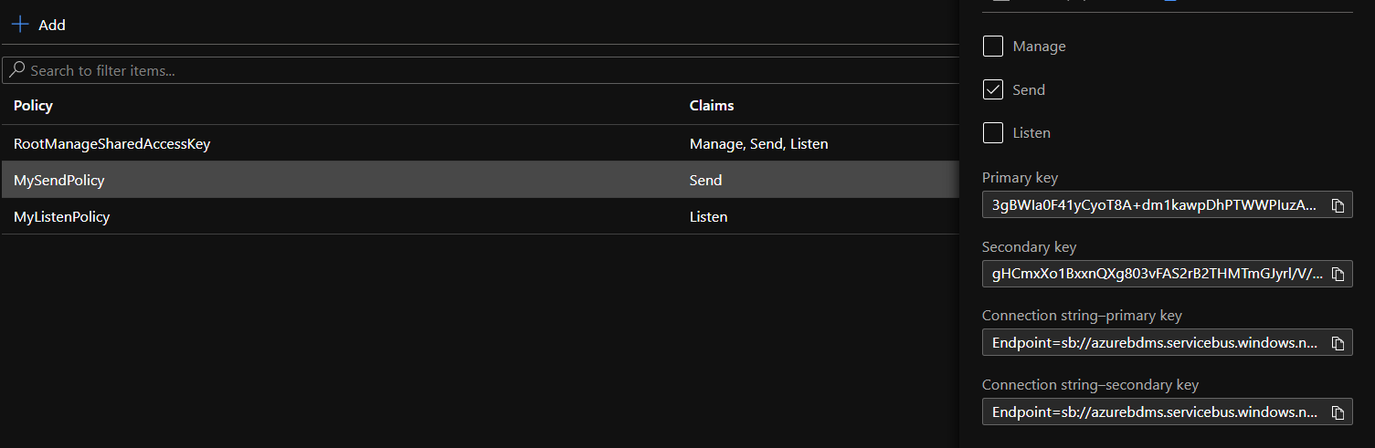
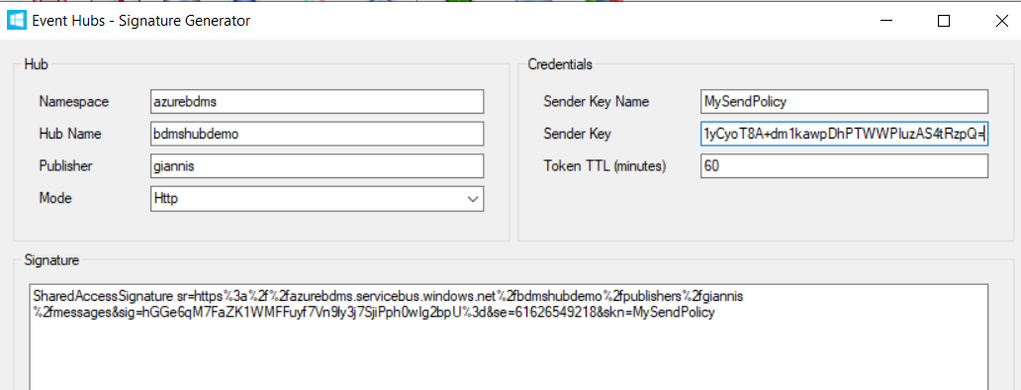
Send Policy & Data setup of data Feed
We have created a Send policy, and passed the data to Signature Generator

Slide 4
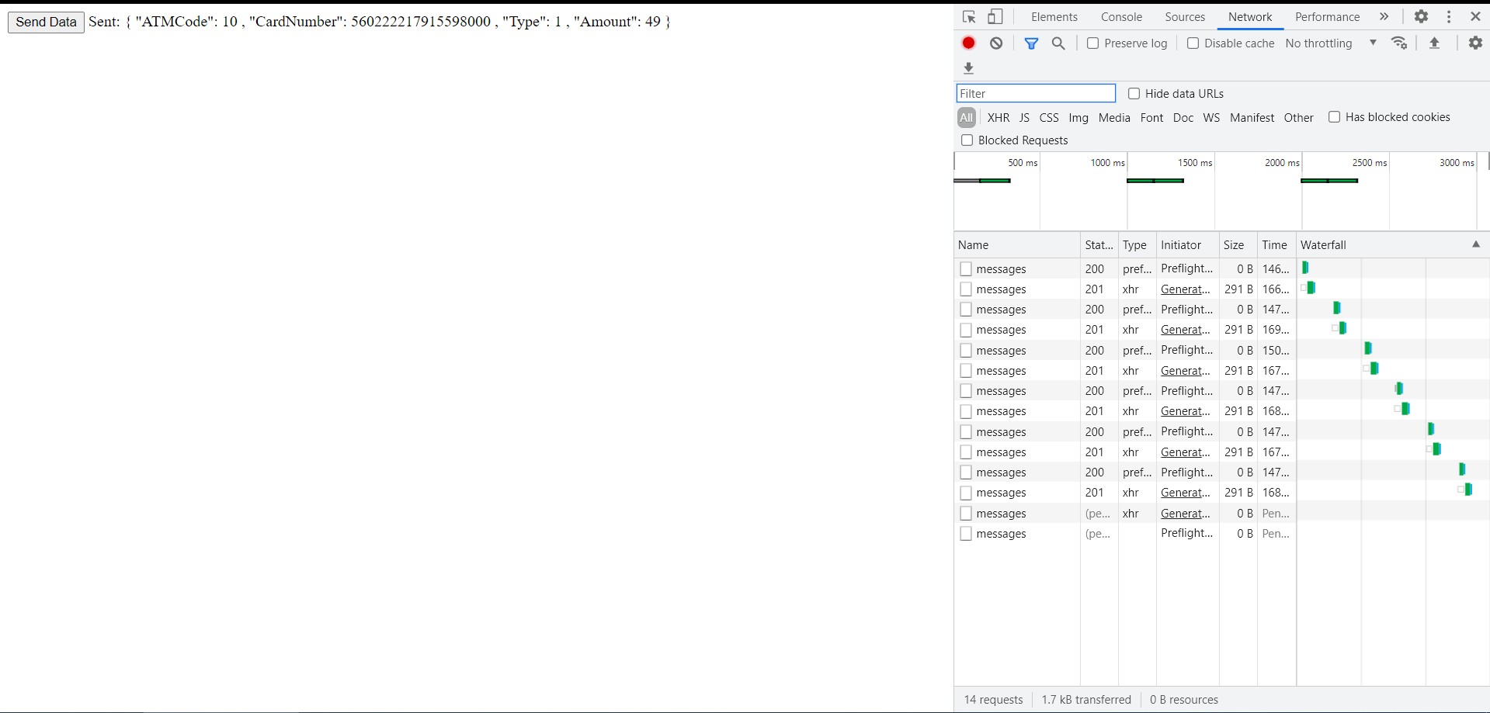
Send Policy & Data setup of data Feed
We edited the data to our generator file, and fed our Job with Stream data.

Slide 5
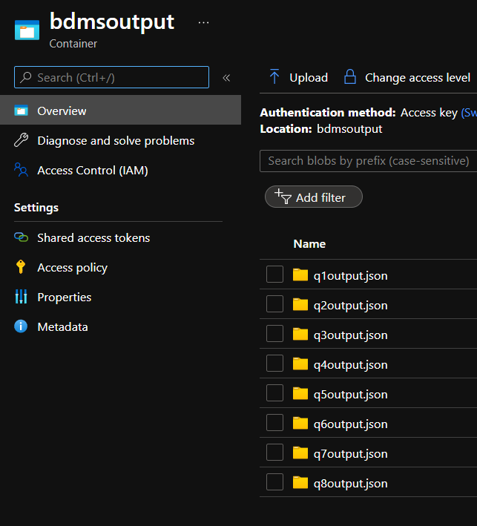
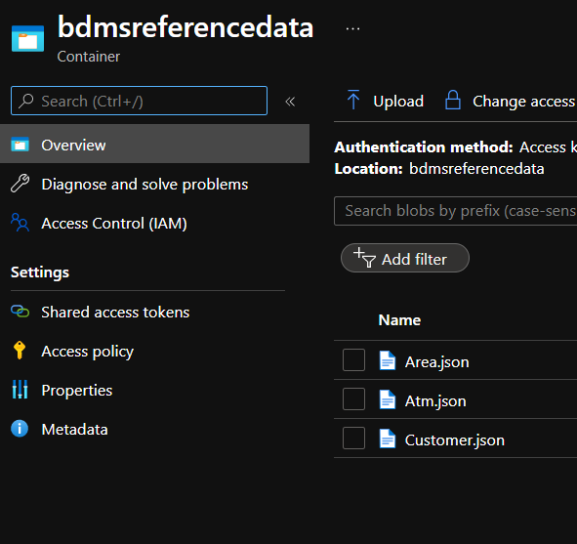
Storage Account Containers’ setup
Now we go and create 2 containers within our Storage Account. 1 for reference input data, and 1 for output. (The output container is initially expected to be empty). We upload the reference data to the input container.

Slide 6
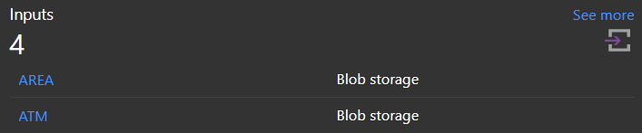
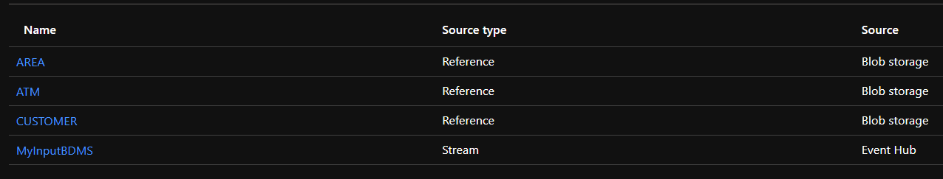
Stream Analytics Job - Input
Then we go on and set the input in our Streaming Job. We use the three inputs for the reference data we imported, and one for our streaming data

Slide 7
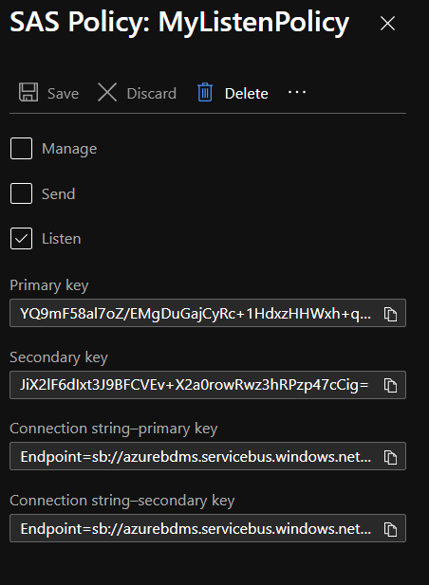
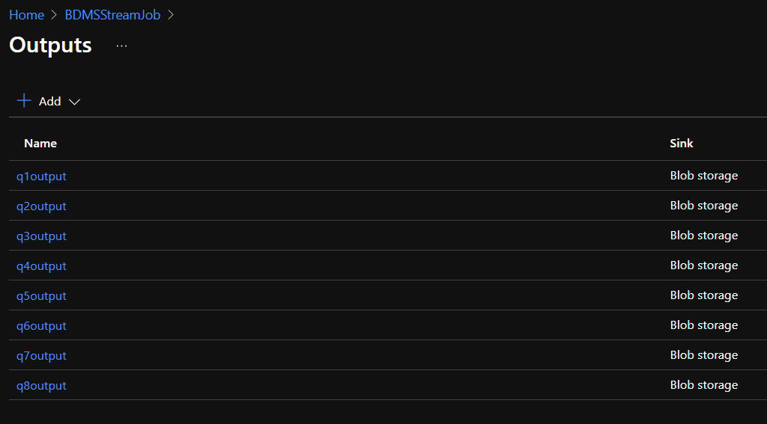
Azure - Output folders
We also create a Listen policy, and then connect our Streaming Job with 8 Outputs (one for each Query). We do this, so as to achieve parallel activation of our queries.

Slide 8
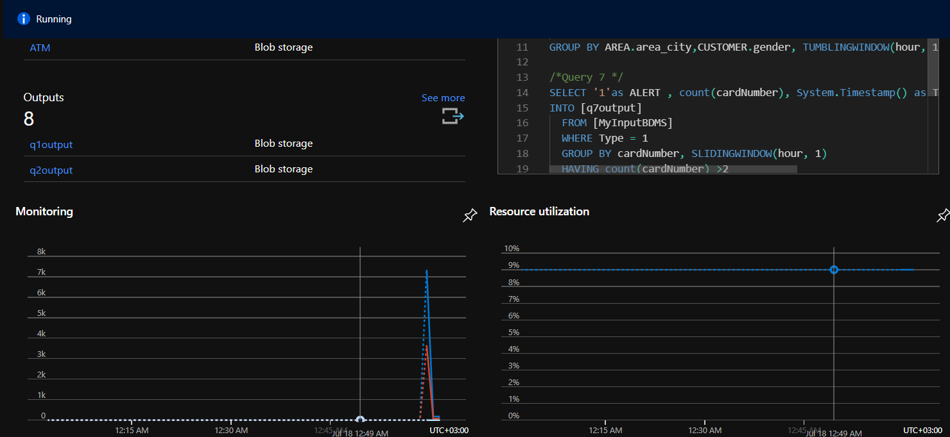
Azure - Query writing
We write our queries, and split them to two groups of implementation. We see that we have in our query window more than one actual queries, and our job is up and running

Slide 9
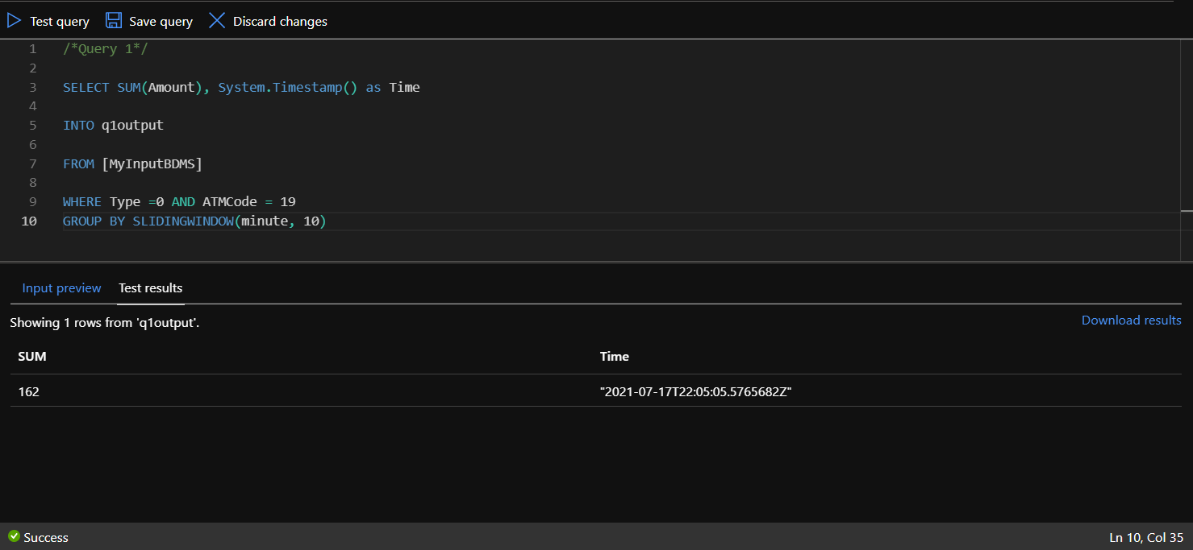
Azure - Query 1 Test

Slide 10
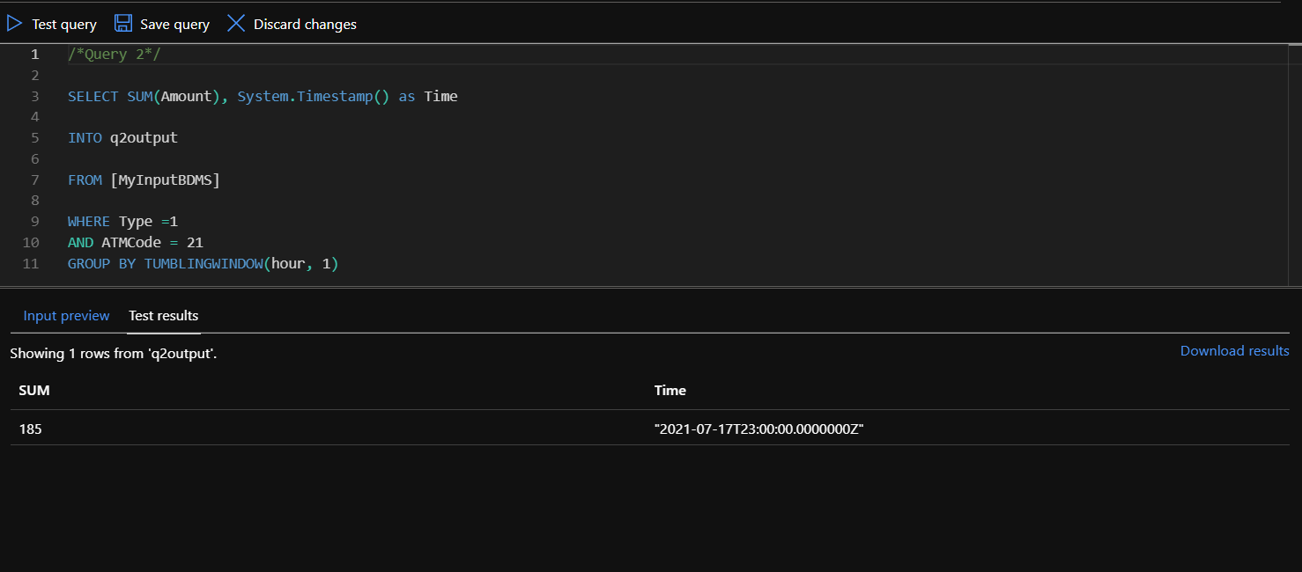
Azure - Query 2 Test

Slide 11
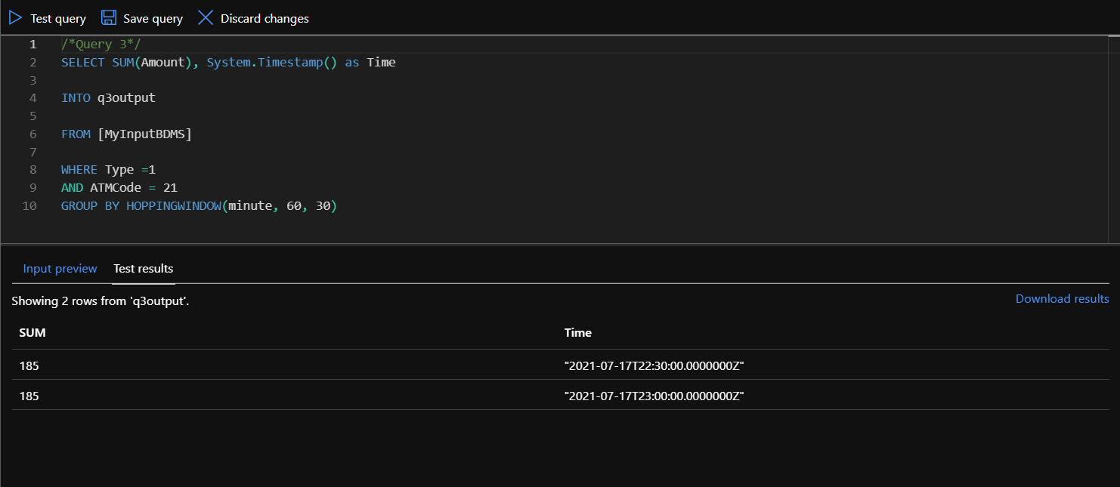
Azure - Query 3 Test

Slide 12
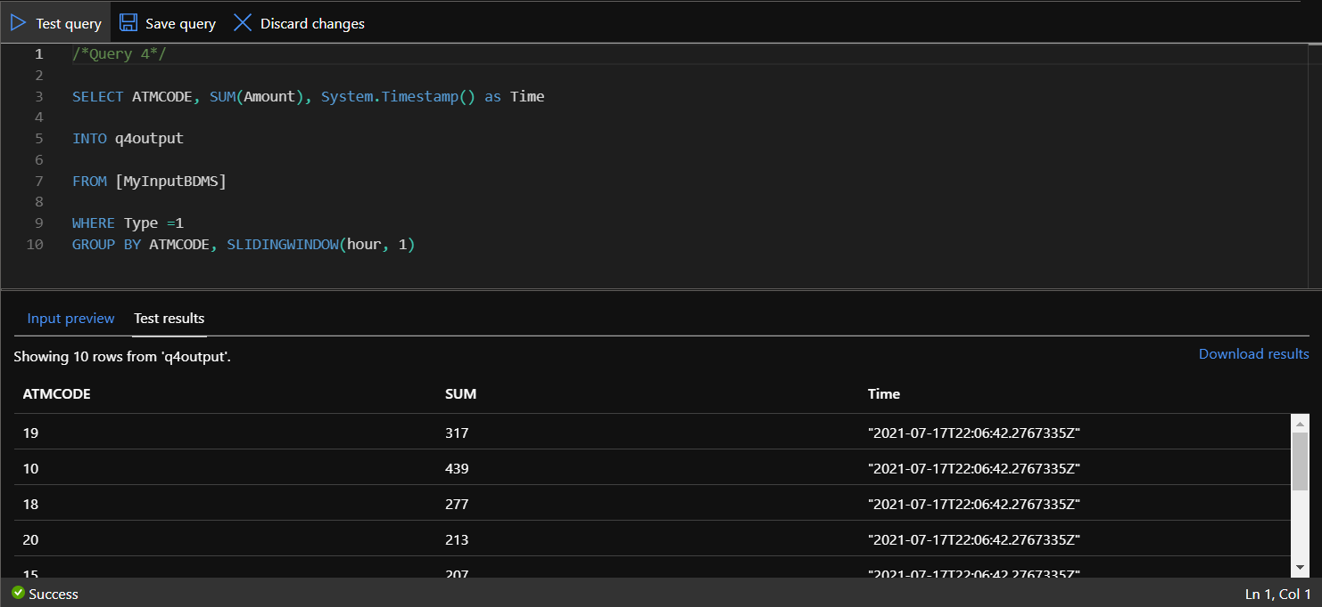
Azure - Query 4 Test

Slide 13
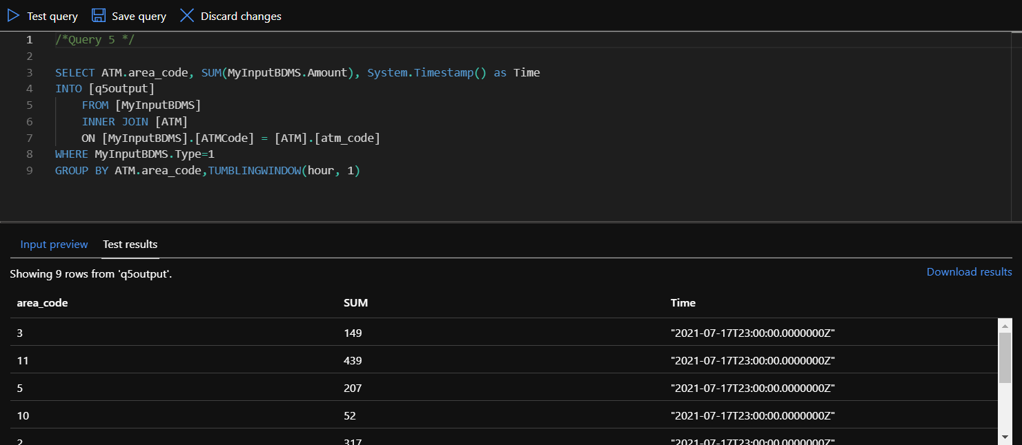
Azure - Query 5 Test

Slide 14
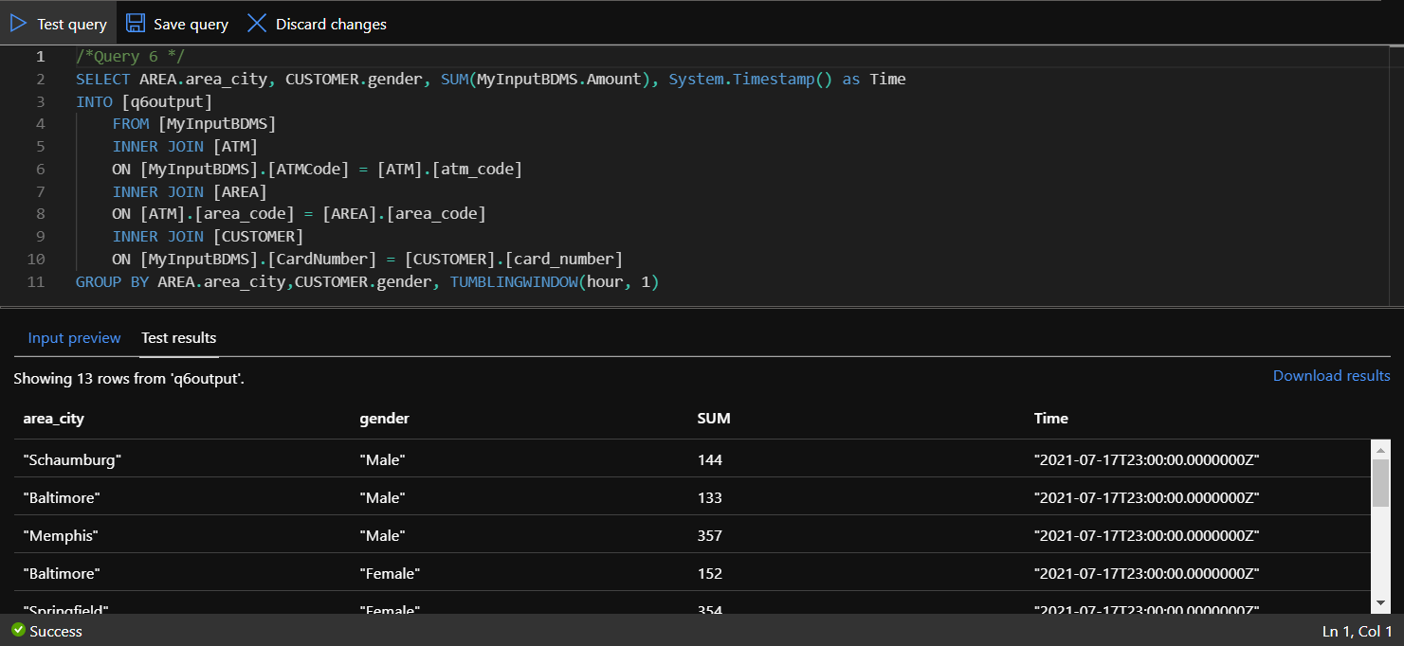
Azure - Query 6 Test

Slide 15
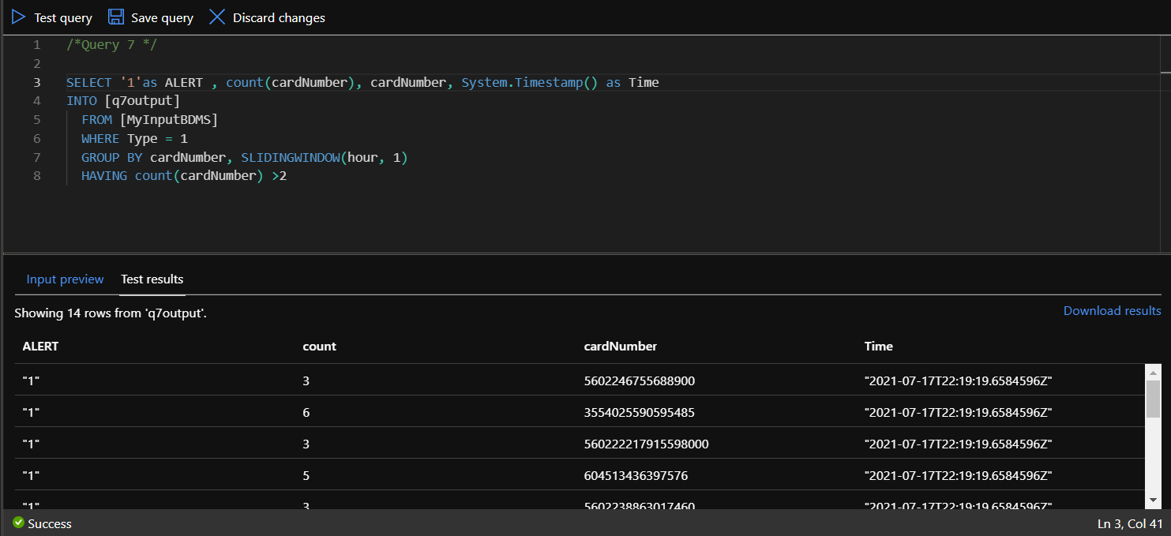
Azure - Query 7 Test

Slide 16
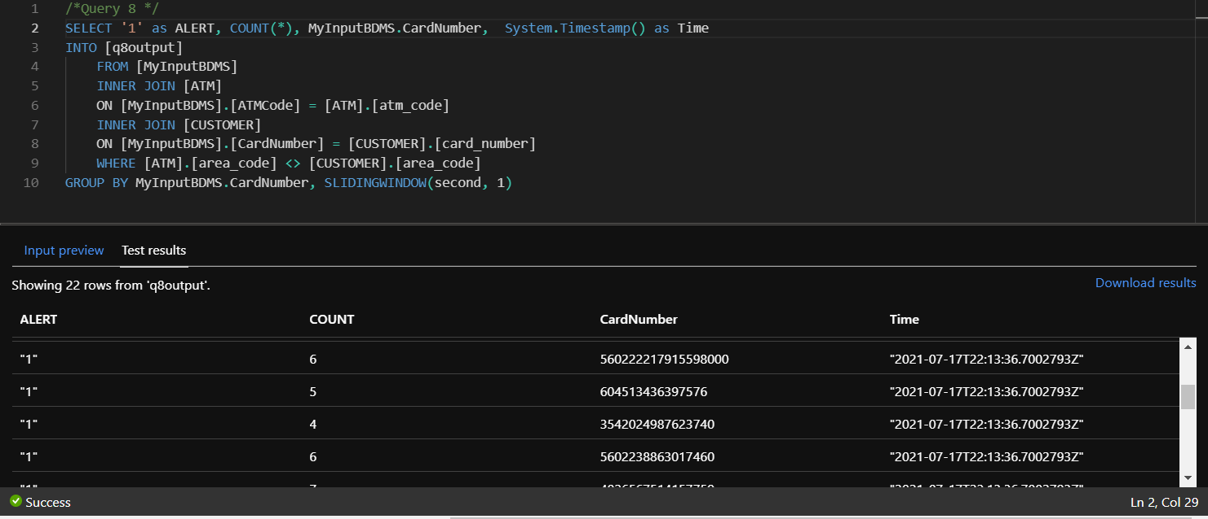
Azure - Query 8 Test

Slide 17
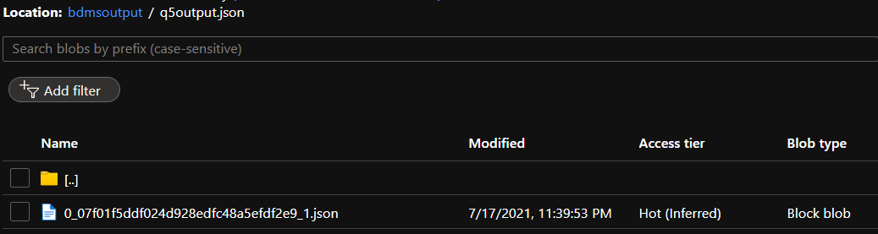
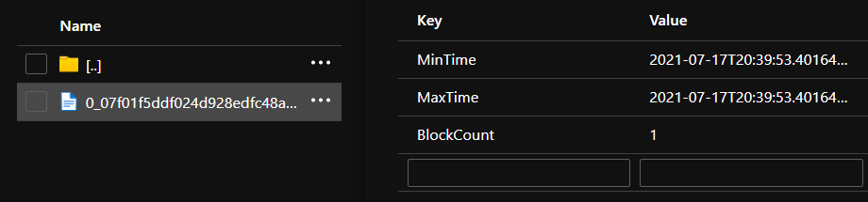
Output preview

Slide 18
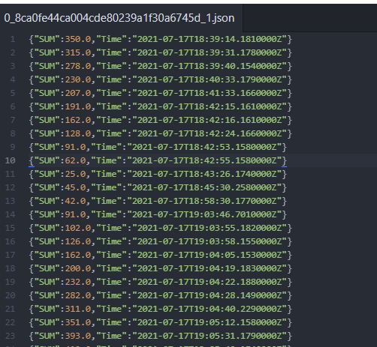
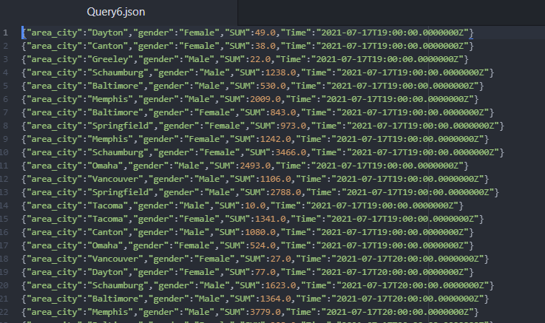
Output file preview

Slide 19
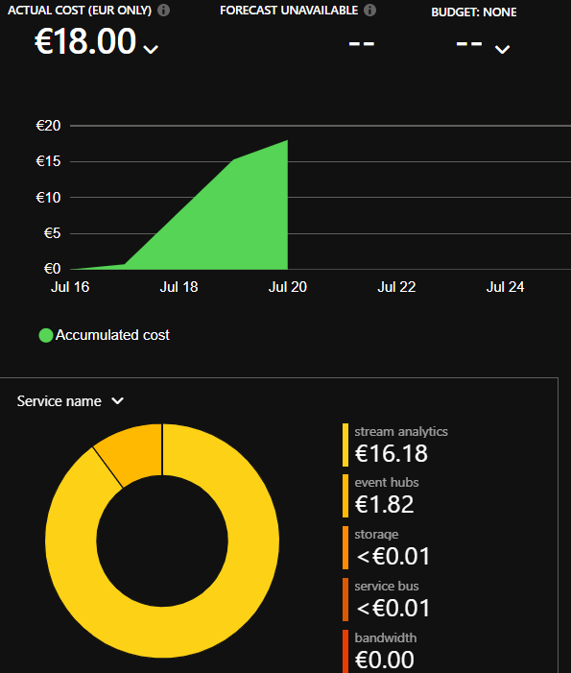
Cost Analysis
We can see what the billing looks like, after two days of running. This is due to the fact that the steam job was active, but the data feeding page was not. So, no actual data processing or any kind of data writing in our storage account was involved.

Slide 20
Get in touch with the code
The Query file, as well as the output files (renamed for clarity) are also available through this link

